Slide 1
Insight Features Overview
Enterprise Reporting Project
April 25th, 2025

Slide 2
Solution Introduction
Insight is a comprehensive, enterprise-wide reporting data warehouse with advanced reporting and business intelligence capabilities. Insight is accurate, reliable, and agile – providing customers with an integrated system of data, easy-to- use dashboards, and analytics. This advanced reporting solution enables data- driven decisions based on strategic business insights.
If you are a report creator, user or manager, Insight changes the way that you
evaluate your organization’s data. Insight incorporates information from multiple sources into a single data warehouse, allowing you to view and compare data in new ways. Insight is user-friendly, with easy drag and drop functionality and new reporting features such as graphs, maps and dashboards. Through Insight, you can use any of the pre-built common reports or the ad hoc functionality to build your own reports that meet your agency’s specific reporting needs.
This Product Guide accompanies the Insight demonstration and provides a detailed look at some of the key features that are available in Insight.

Slide 3
General Navigation

Slide 4
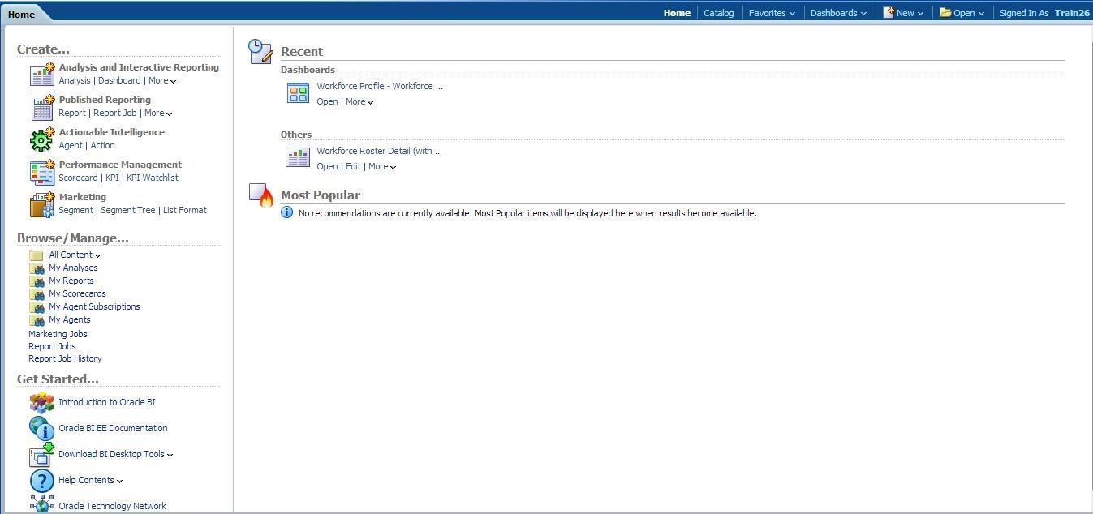
General Navigation
1 of 1
The home screen provides intuitive navigation of the features of Insight
The “Create” section allows you to start a new report (or “Analysis”), while “Browse/Manage” provides another way to access your existing reports and dashboards.
The “Top Navigation Bar” contains the common controls. This menu is always visible while logged in. From this area you can open existing reports, create new reports, access your dashboards, mark favorites or browse the pre-built reports through the Catalog.
The “Recent” section lists your most
recently used reports and dashboards.
The “Most Popular” section features the most frequently accessed reports by users in your community.

Slide 5
Standard Reports

Slide 6
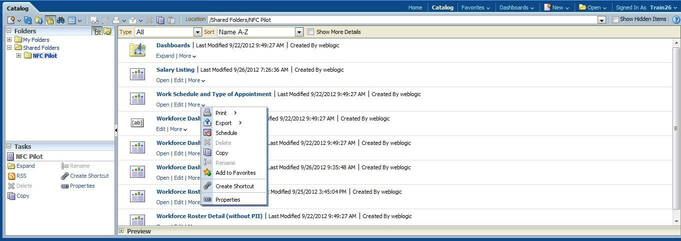
Standard Reports
1 of 2
Insight includes a number of pre-built reports based on the common reporting needs of our customer organizations. These reports were developed in partnership with representatives from our customer agencies. The pre-built reports are available in Insight via the Catalog.
From the Catalog you can open common reports, as well as edit and save them to My Folders for customized use.
All common reports and any saved ad hoc reports are all available through the Catalog.
You can also access a number of additional edit, print, or export functions directly from the Catalog.

Slide 7
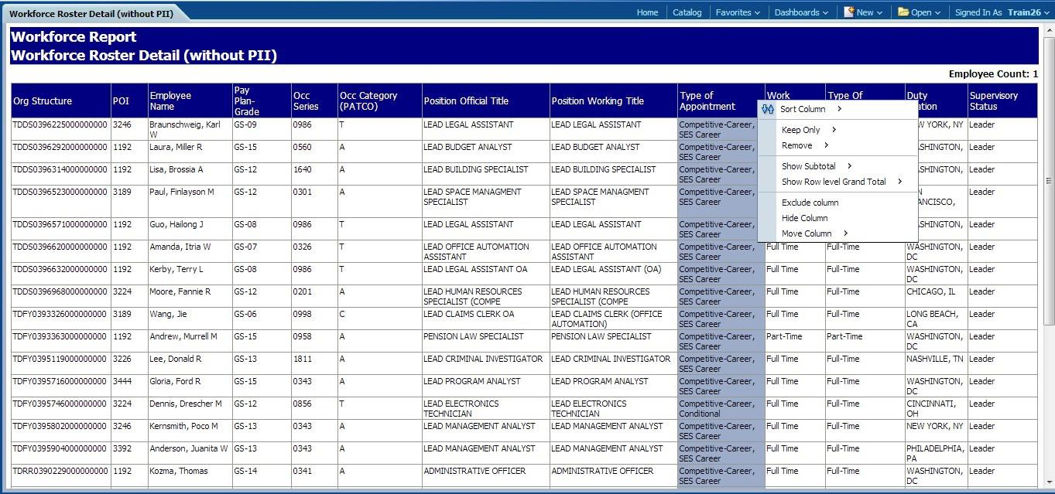
Standard Reports
2 of 2
When you open a report, the default view is a table of data based on the selected filters.
When you run a report, a table of data appears.
You can select columns and drag them to new positions in the table, as well as easily sort or exclude columns.

Slide 8
Ad Hoc Reports

Slide 9
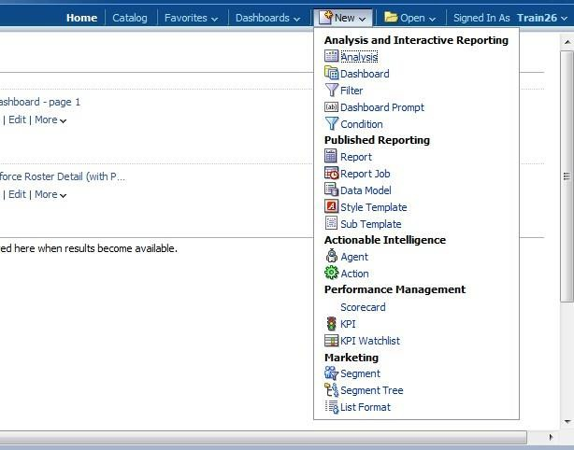
Ad Hoc Reports
1 of 5
Insight includes ad hoc reporting functionality which allows you to create agency-specific reports with the data elements available in the solution. Insight provides flexibility with your data - combining data elements, creating new reports, and displaying results in multiple formats such as graphs, maps, and trending visuals.
Create a new report, or Analysis, via the “New” tab on the top navigation bar.

Slide 10
Ad Hoc Reports
2 of 5
You can create an ad hoc report with the data elements available to you based on your user role in the solution. Creating a report is as simple as selecting the data elements and dragging them to the working area for additional editing.
Select the data elements to include in the report from the “Subject Area”.
Drag and drop data elements into columns.
Sort or edit column properties such as formatting and creating filters.
You can select the data that appears in your
report by adding a filter.

Slide 11
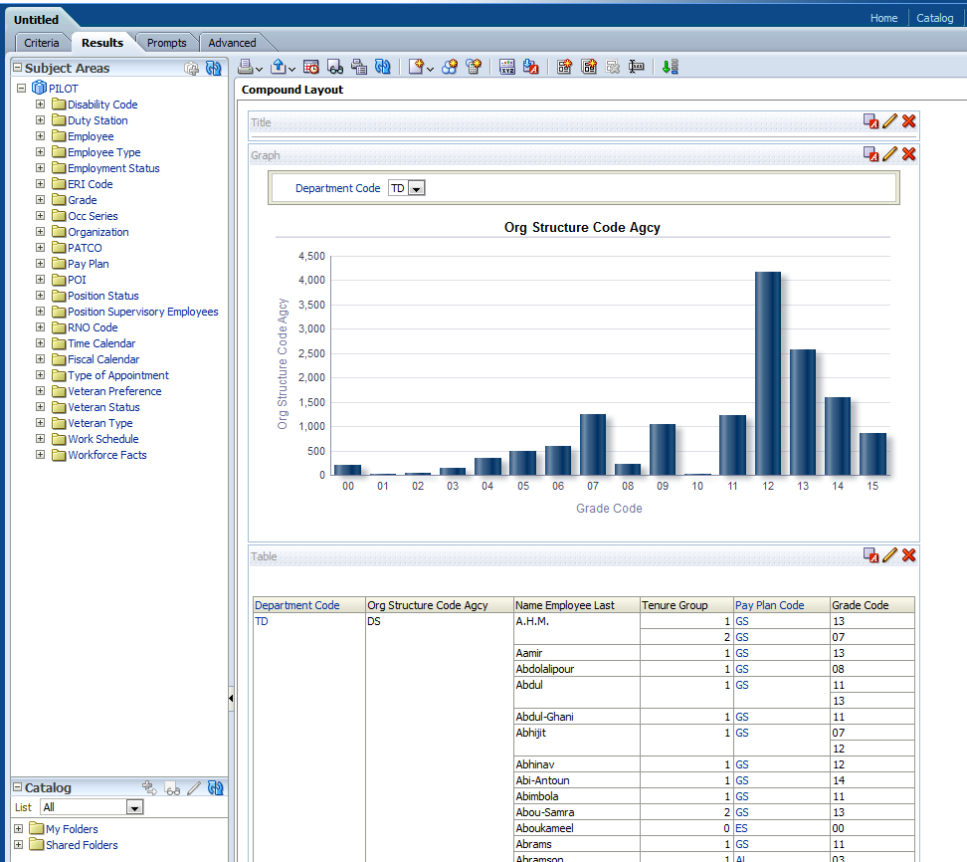
Ad Hoc Reports
3 of 5
Viewing your ad hoc report is seamless through the “Results” tab. This tab displays your data in a table format, but you can also add additional views including graphs, pivot tables, and maps.
Select views to add to the report such as pivot tables or graphs.
Title your graph and save it for future use or to include in a dashboard.
See your data selections in multiple graph formats.

Slide 12
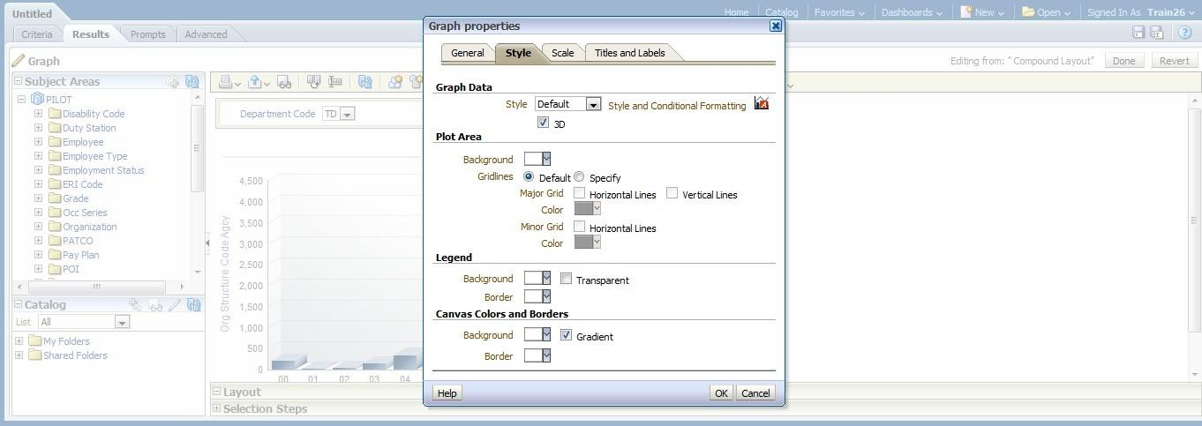
Ad Hoc Reports
4 of 5
Insight allows further customization of your reports, including changes to color, 3D style, size, scale, titles and labels.
Edit the titles and axis labels to customize your graph.
Change the canvas and graph. colors.

Slide 13
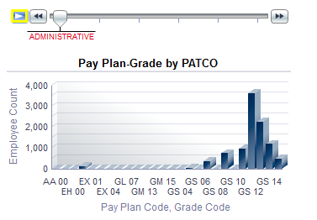
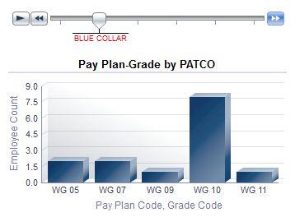
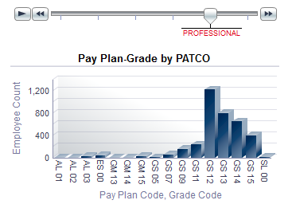
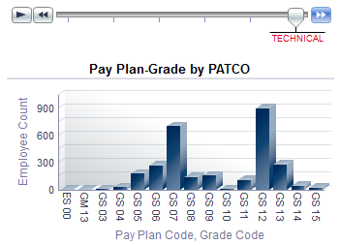
Ad Hoc Reports
5 of 5
Insight graphs also include the functionality to view changes in information over time or data sets. The example portrayed demonstrates this functionality with Pay Plan Codes and Grade Codes based on level.
Move the slider bar to animate the graph to display the next data set.

Slide 14
Standard Dashboards

Slide 15
Standard Dashboards
1 of 4
In addition to common reports, Insight also includes a number of common dashboards. Dashboards combine several reports in one executive-level view to provide a range of data on a specific topic.
Common Dashboards are accessible from any screen through the top navigation bar.
You can browse dashboards from the home screen through the Browse/Manage section, or in your recent files.

Slide 16
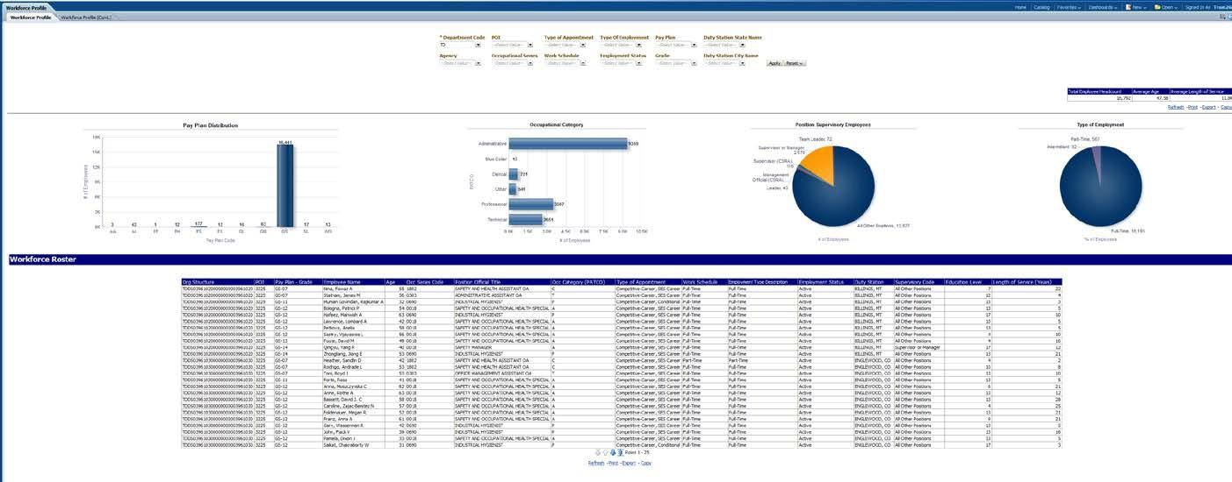
Standard Dashboards
2 of 4
Dashboard prompts are included to customize the data viewed in the dashboard.
Standard dashboards provide aggregated reports as well as several visualizations of the data.
You can filter a standard dashboard
for specific data results using the prompts at the top.

Slide 17
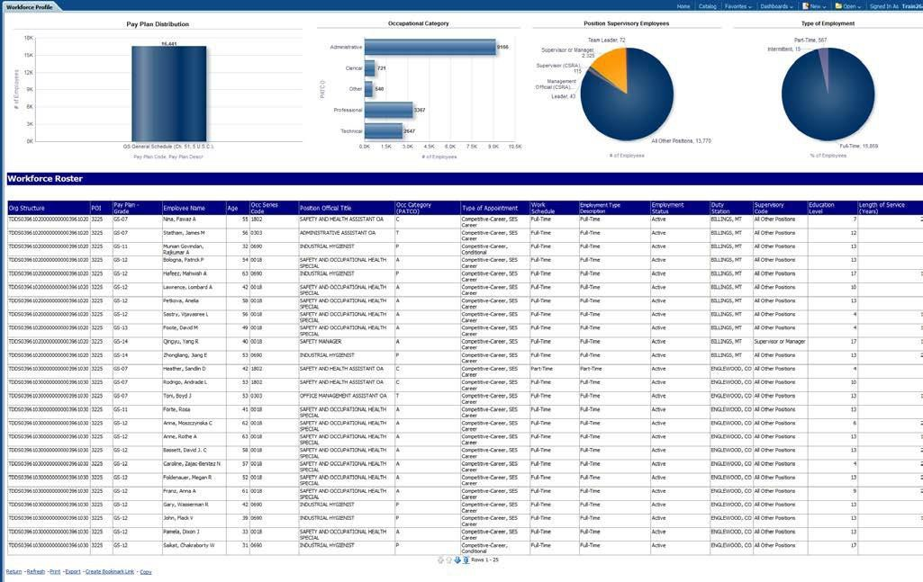
Standard Dashboards
3 of 4
With Insight dashboards, you can dig deeper into specific data using the “drill-down” feature. To drill down, select the desired data set from a graph. In this example of a drill-down, we clicked on the GS General Schedule bar in the dashboard above to see more details about this data area.
The charts and report table are updated automatically to reflect the selected data element.

Slide 18
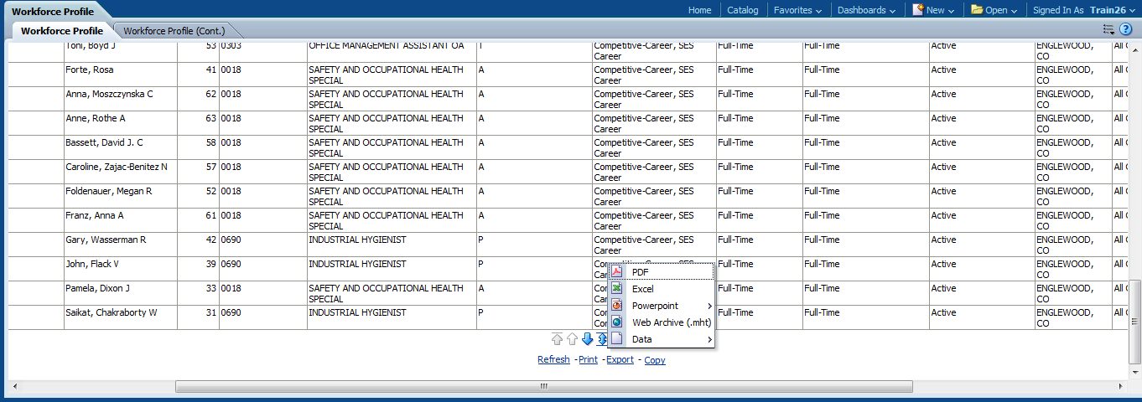
Standard Dashboards
4 of 4
There are several options to easily print, export, or copy dashboards into workable files. Print and export options include: Excel, PDF, PowerPoint, Web Archive or Data formats.
Export the dashboard in a number of formats.
Refresh, Print, Export or Copy the dashboard.

Slide 19
Creating a Dashboard

Slide 20
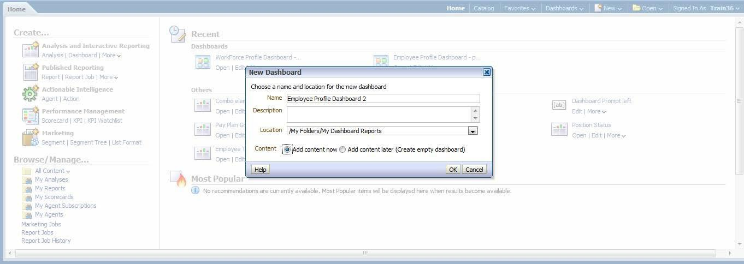
Creating a Dashboard
1 of 3
You can create an ad hoc dashboard with any reports that are available in your personal or shared folders, including common reports and ad hoc reports.
Create and save your new dashboard to your personal folder.
To open a new dashboard, use the “New” drop down menu from the top navigation bar.

Slide 21
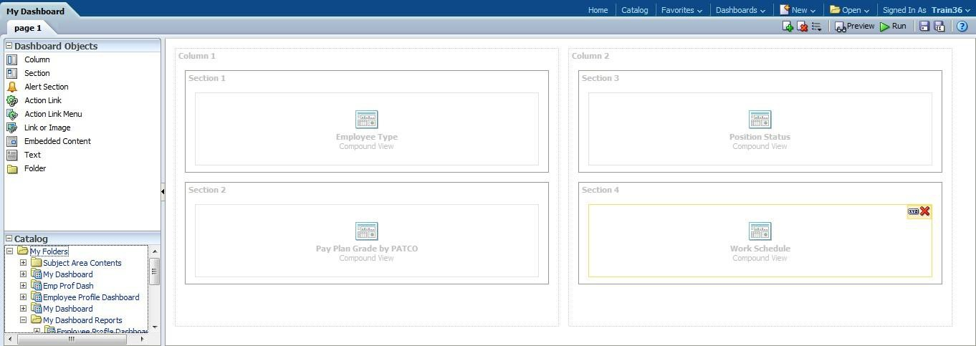
Creating a Dashboard
2 of 3
Customize the design of an ad hoc dashboard by selecting the columns, sections, and text to include in the dashboard. You can also select the display position of reports in the dashboard.
Drag and drop dashboard objects such as columns to the staging area.
Sections divide columns and provide space to add reports.
Drag and drop common or ad hoc reports from your catalog to the dashboard panes.

Slide 22
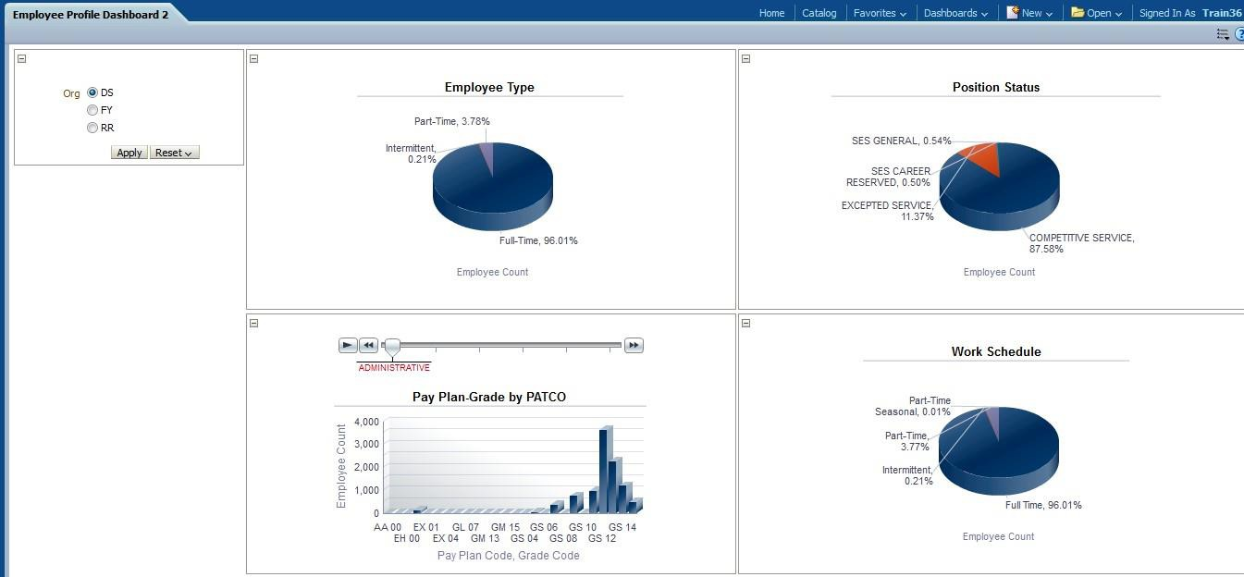
Creating a Dashboard
3 of 3
Previewing the completed dashboard displays all of the reports selected. The formatting of each report, including whether it displays a graph or a table of data, is selected when building the report.
Each report appears as defined in the dashboard setup.

Slide 23
Customizing Dashboards

Slide 24
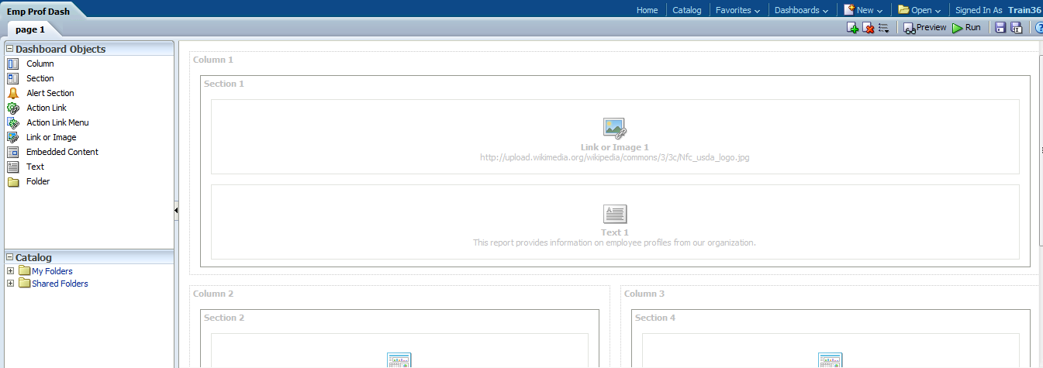
Customizing Dashboards
1 of 2
Insight provides a number of different options to customize reports and dashboards, which is a great way to put your agency’s unique touches on an analysis before printing or sharing.
In addition to reports, Insight allows you to include other objects such as images, text boxes, or links to other reports or folders in Insight.

Slide 25
Customizing Dashboards
2 of 2
A customized dashboard can be printed or exported directly from Insight, ideal for management or executive review.

